Slide 1
BB2950 Day 13: Tuesday 11-14-17
Learning objectives:
Explain how Cas9-induced double-strand breaks can be repaired by NHEJ or by HDR (homology-directed repair) to achieve different genome engineering goals.
Explain how conventional DNA sequencing (Sanger sequencing) is used to sequence DNA.
Explain how Illumina sequencing (a type of “next generation” sequencing) is used to sequence DNA.
Explain why the two DNA sequencing technologies described above are complementary.

Slide 2
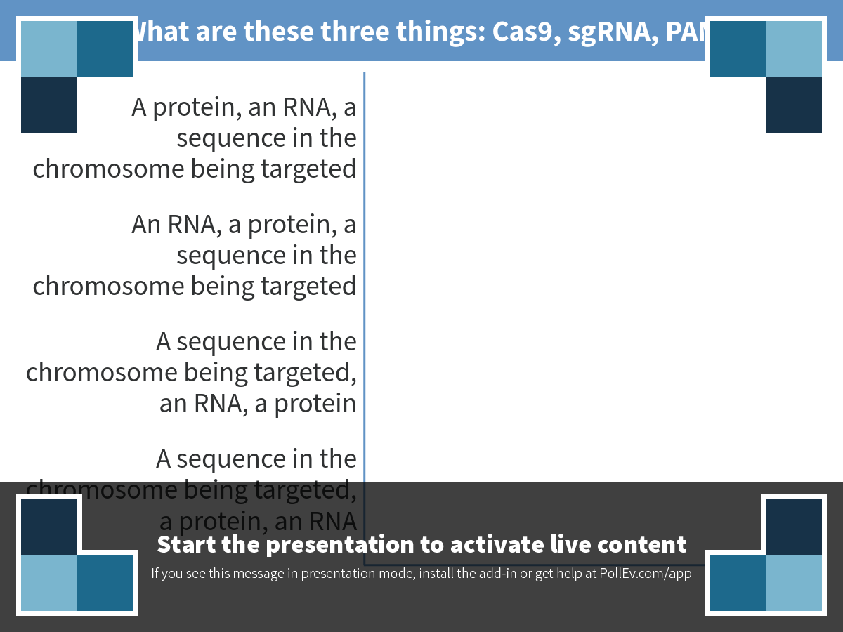
Notes:
What are these three things: Cas9, sgRNA, PAM
https://www.polleverywhere.com/multiple_choice_polls/0WzUMZm6BzIaUMl

Slide 3
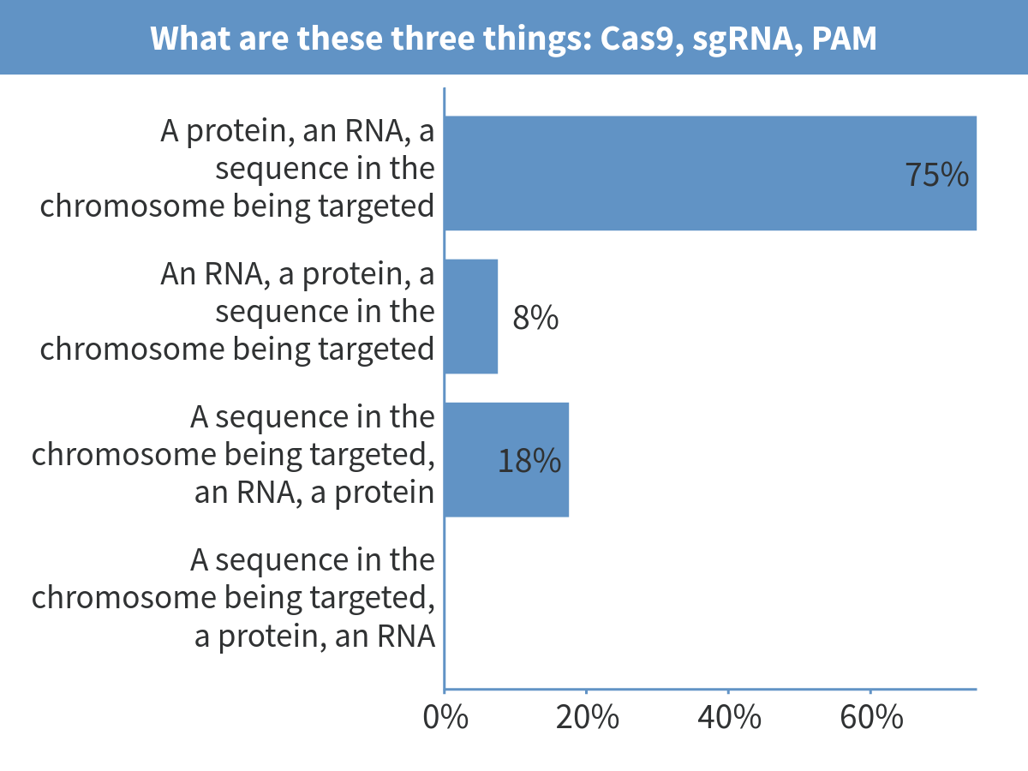
Notes:
What are these three things: Cas9, sgRNA, PAM

Slide 4
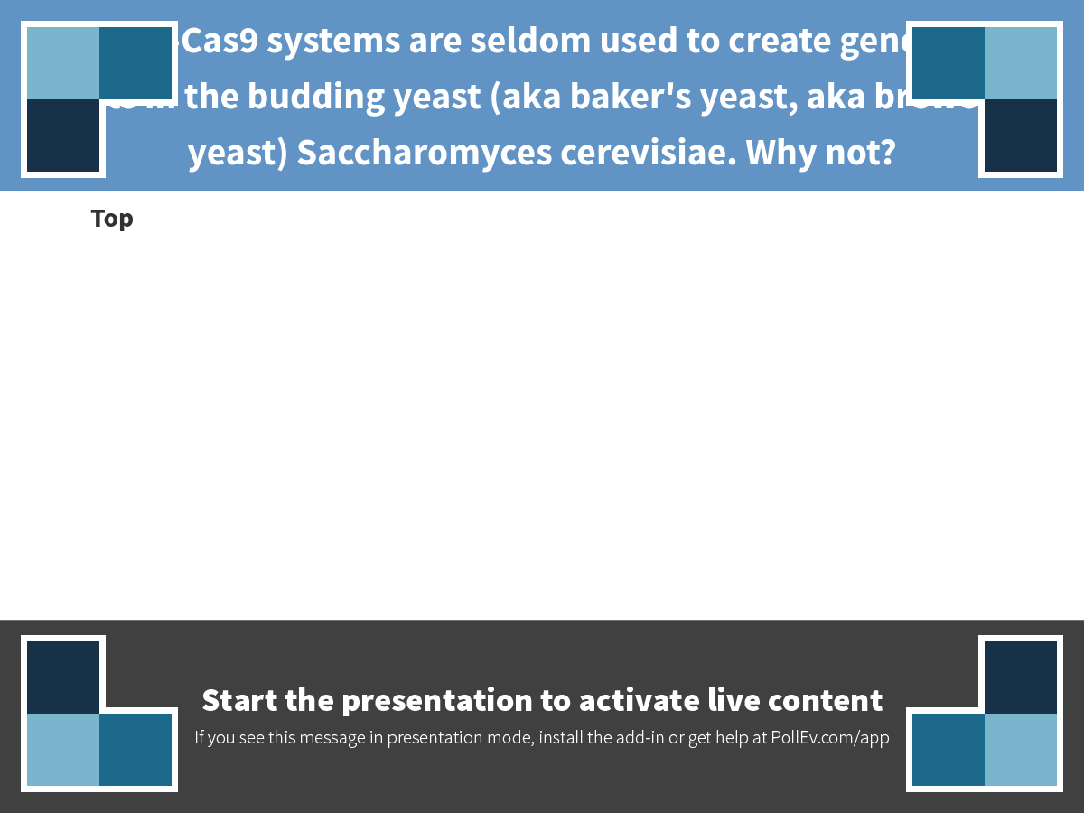
Notes:
CRISPR-Cas9 systems are seldom used to create gene knock-outs in the budding yeast (aka baker's yeast, aka brewer's yeast) Saccharomyces cerevisiae. Why not?
https://www.polleverywhere.com/discourses/nucfg375PH9w73q

Slide 5
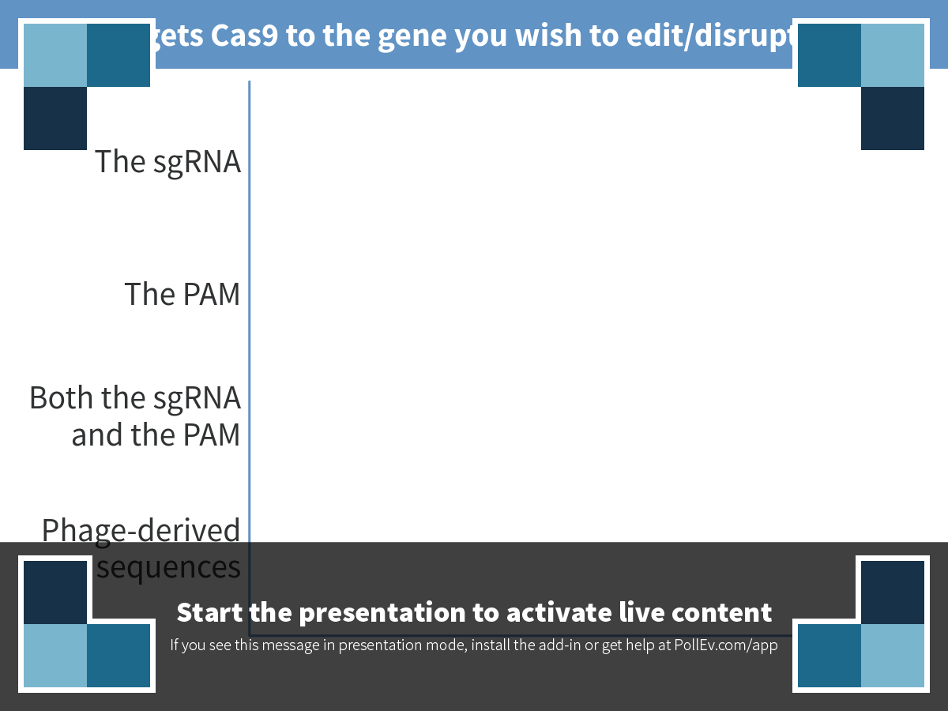
Notes:
What targets Cas9 to the gene you wish to edit/disrupt/modify?
https://www.polleverywhere.com/multiple_choice_polls/2HbAfZq0TT5wbzX

Slide 6
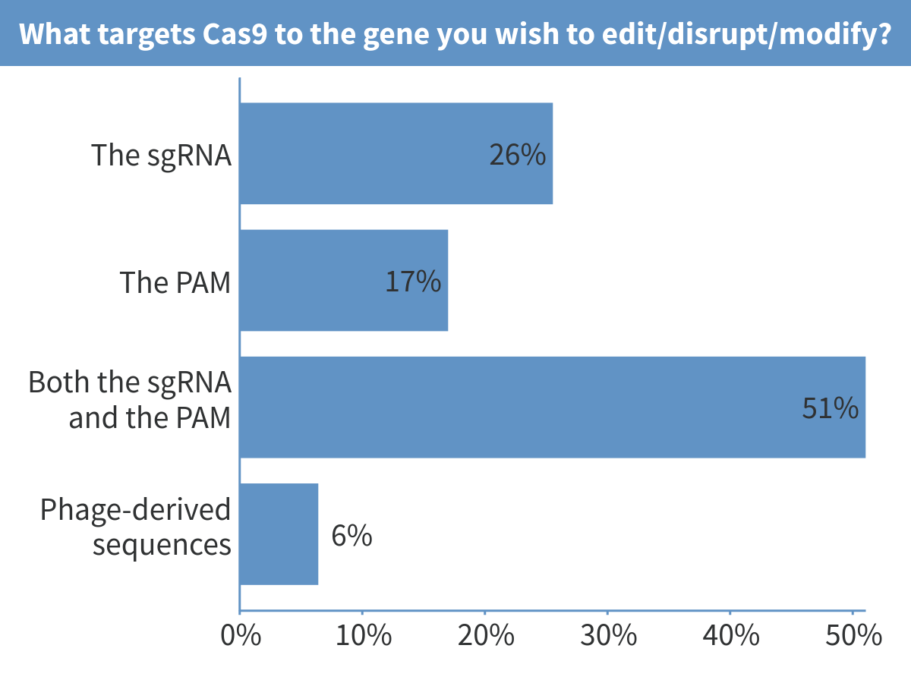
Notes:
What targets Cas9 to the gene you wish to edit/disrupt/modify?

Slide 7
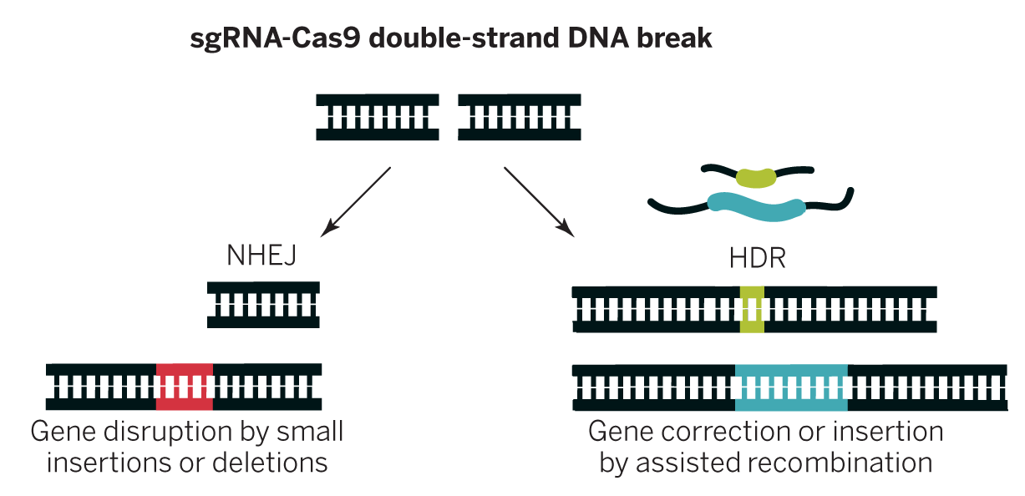
Cas9-induced double-strand breaks can be repaired in two ways useful for genetic engineering
Doudna and Charpentier. Science 2014;346:1258096
Notes:
Why would you want to use the NHEJ method? The HDR method?

Slide 8
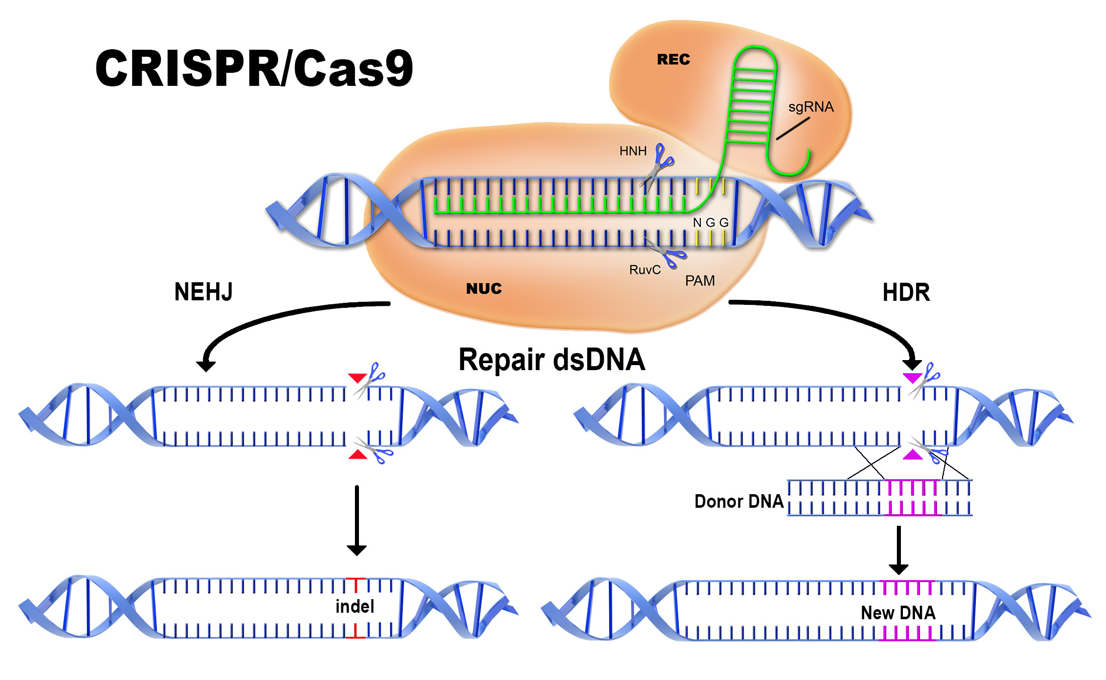
Another view of CRISPR-Cas9 genome editing
Cas9
Non-homologous end joining
Homology-directed repair
Graphic from: http://www.aati-us.com/product/fragment-analyzer/CRISPR

Slide 9
Components needed for CRISPR-Cas9 genome editing/gene modification/genetic engineering

Slide 10
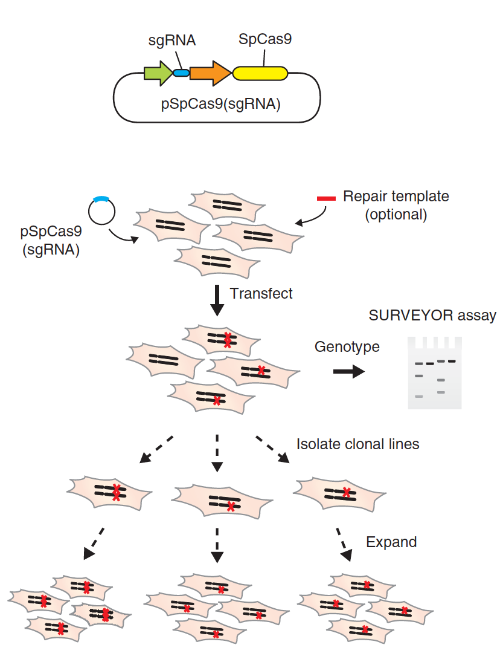
A basic CRISPR-Cas9 genome editing workflow
Make plasmid
Ran et al (2013). Nature Protocols, 8(11), 2281–2308. http://doi.org/10.1038/nprot.2013.143

Slide 11
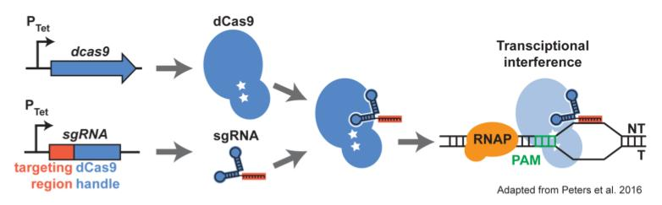
Variants of CRISPR-Cas9 technology allow us to do other useful things
Example: Using catalytically dead Cas9 to block transcription
Why is this useful?
Rock, J. M., Hopkins, F. F., Chavez, A., Diallo, M., Chase, M. R., Gerrick, E. R., et al. (2017). Nature Microbiology, 2, 16274. http://doi.org/10.1038/nmicrobiol.2016.274
Notes:
Effector domains:
Transcriptional activator
Transcriptional repressor
Histone tail modifier
Fluorescent protein

Slide 12
Two general types of DNA sequencing
Sanger
Next generation/deep sequencing
Examples: Illumina, PacBio, Nanopore, Ion Torrent

Slide 13
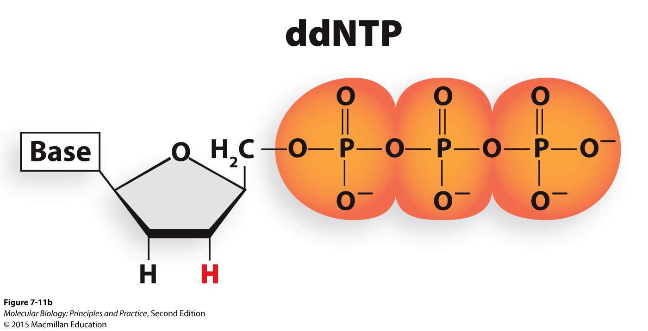
Sanger sequencing uses dideoxynucleoside triphosphates

Slide 14
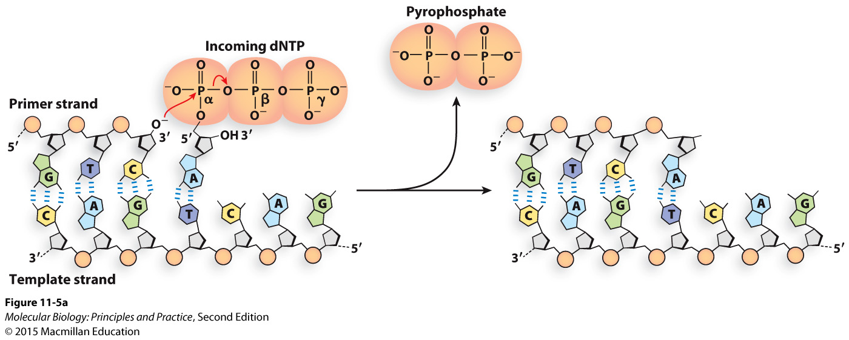
What would be different with ddNTPs?

Slide 15
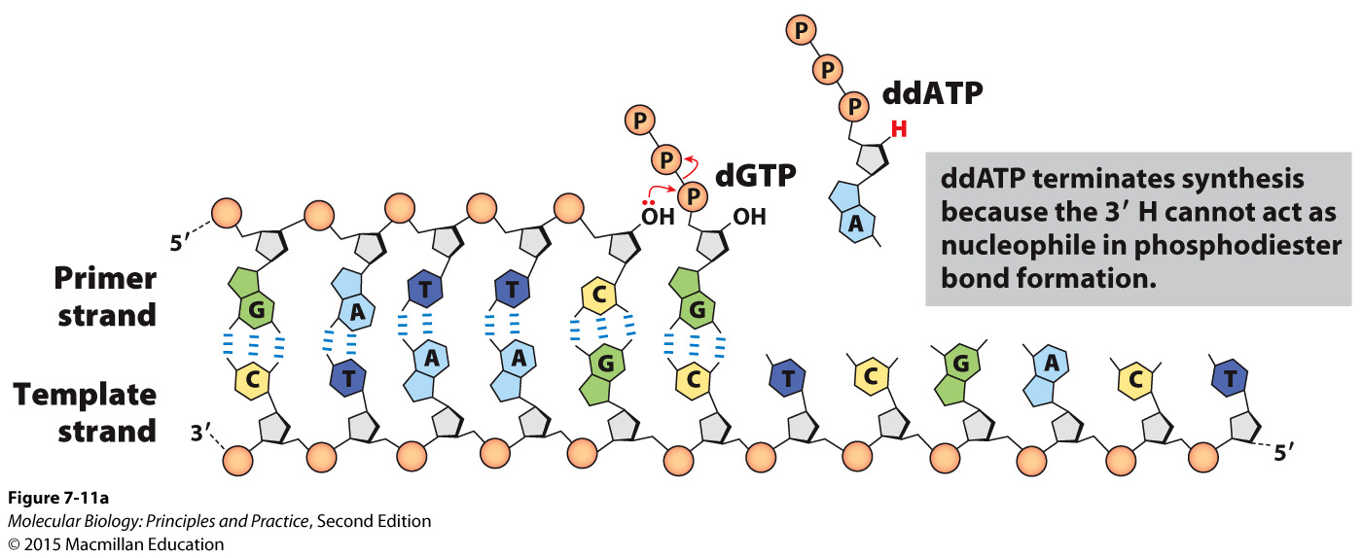

Slide 16
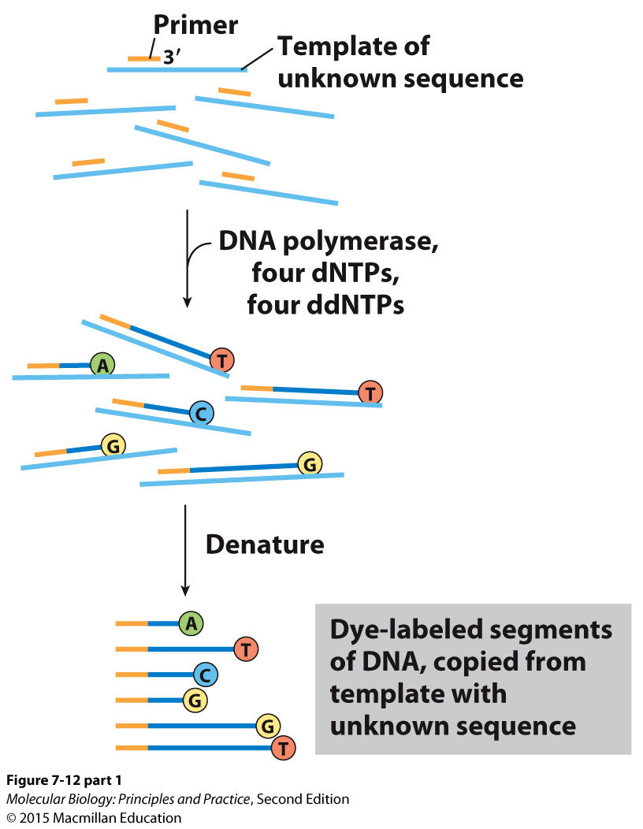
A sequencing reaction is like a PCR with a single primer

Slide 17
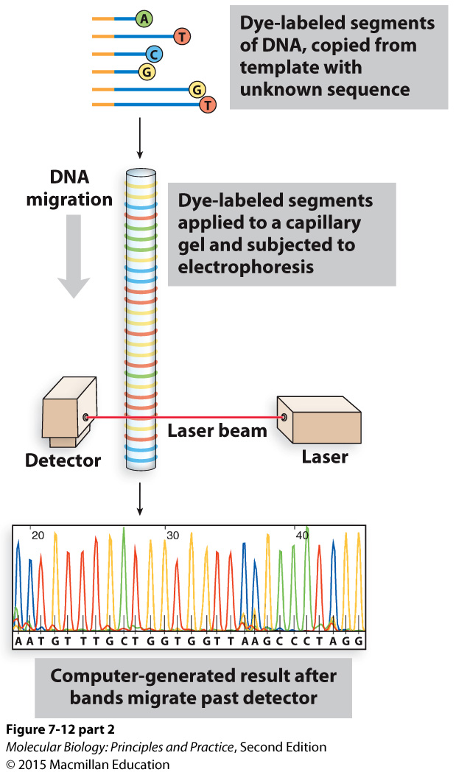

Slide 18
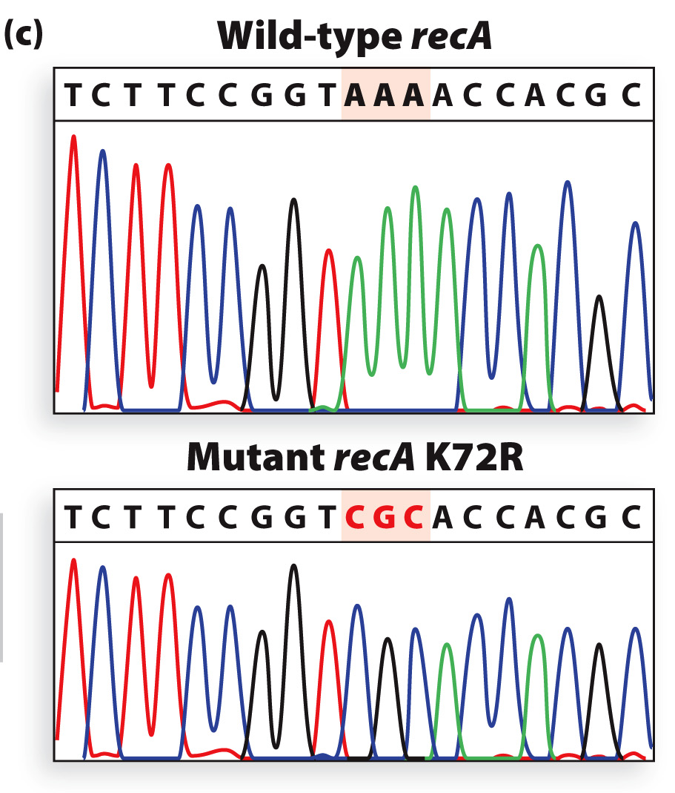
Sanger sequencing reveals that a mutation in recA was correctly inserted

Slide 19
Sanger sequencing uses and limitations
Advantages:
Template can be a plasmid or a PCR product
High-confidence determination of sequence
700-800 nt of continuous sequence
Relatively easy to analyze the resulting data
Limitations:
Need relatively large amount of starting material (do PCR and sometimes cloning first)
1 tube/molecule to be sequenced (we pay $5/reaction)
You need to know enough sequence to design a primer

Slide 20
Next-generation sequencing:
Sequence millions of distinct template molecules in parallel in miniature
Advantages:
Sequence whole genomes cheaply
Very low quantities of starting material needed
Nothing needs to be known about the sequence in advance (no specific primers)
Limitations:
Shorter reads (often)
Not cost-effective for small-scale projects
Analysis requires computational power and expertise

Slide 21
Raw data from one of my experiments
(And millions more lines like these)

Slide 22
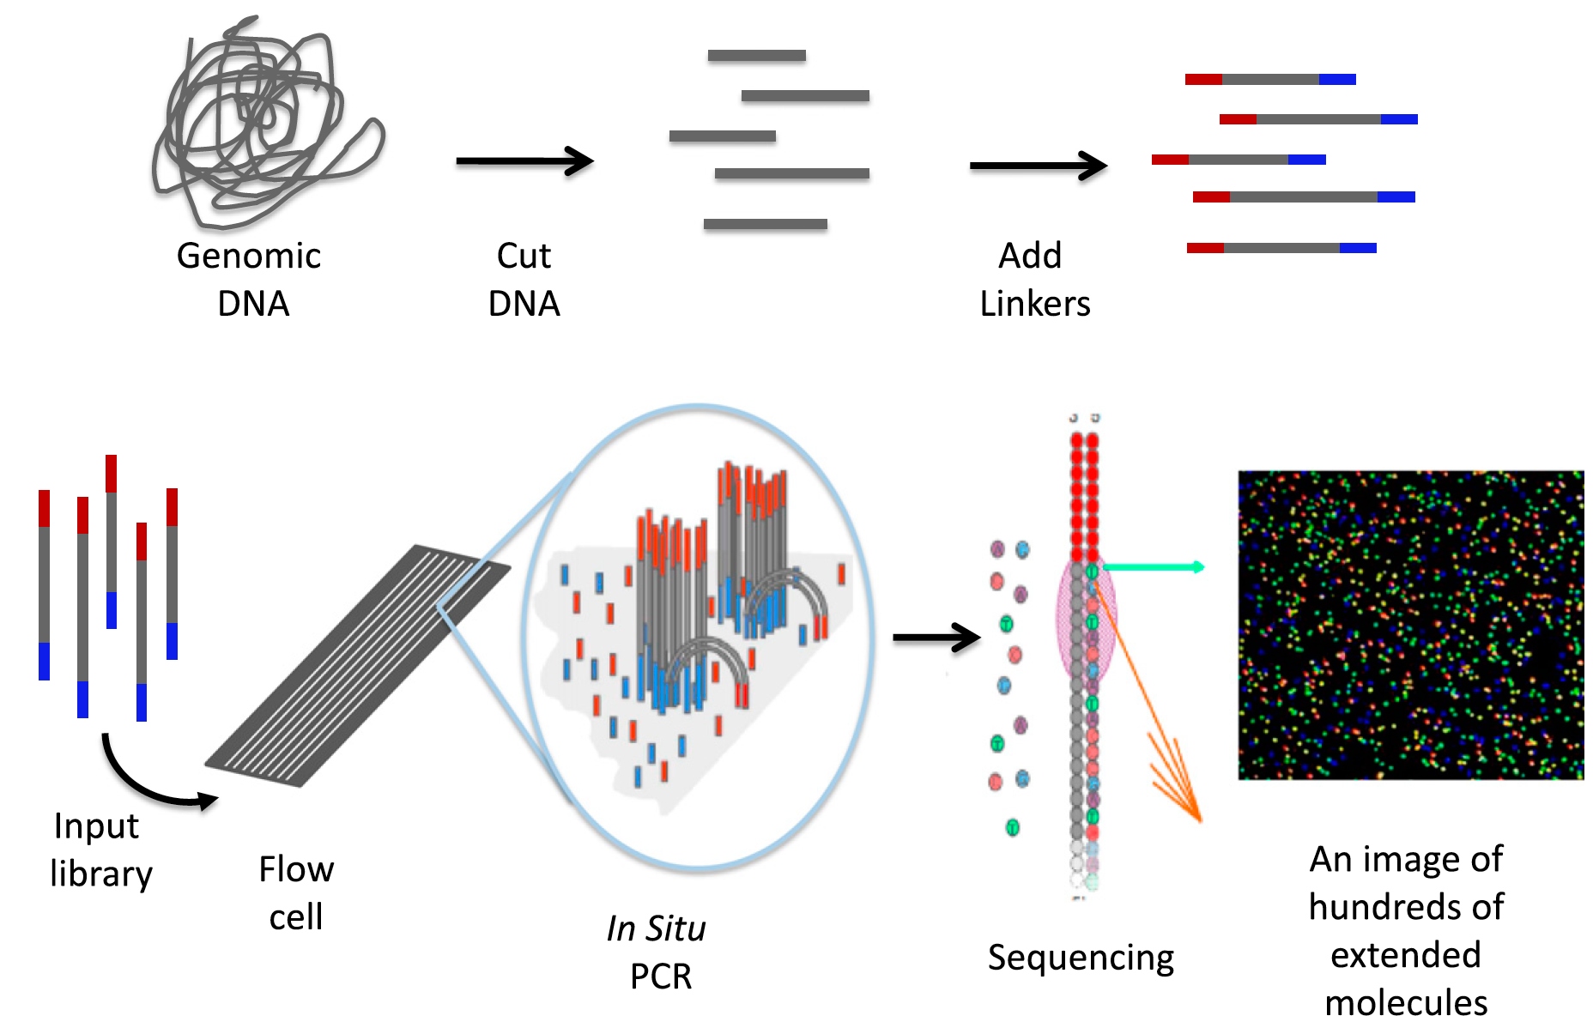
Overview of next-generation sequencing (Illumina)
Shear DNA
Add adapters
Library
Each cluster (dot) reports the sequence of a different molecule
Johnsen J M et al. Blood 2013;122:3268-3275
©2013 by American Society of Hematology
Notes:
Schematic of 1 form of NGS. The process starts by randomly cutting genomic DNA (or cDNA) into short fragments (a few hundred base pairs in length). Oligonucleotide linkers are added to the fragments to generate a library in vitro. Libraries are introduced into a microscope slide with flow channels containing complementary oligonucleotides on the surfaces of the channel to ones on the libraries, thus allowing hybridization to attach millions of individual molecules to discrete locations on the slide. In situ PCR is performed to copy the individual fragments of the library to enhance sequencing detection. Single-base extension by a DNA polymerase with all 4 dye terminators extends the sequence 1 base. The image of the base extension is captured. This cycle and is repeated a 100 times from 1 end of the molecule and 100 times from the other.

Slide 23
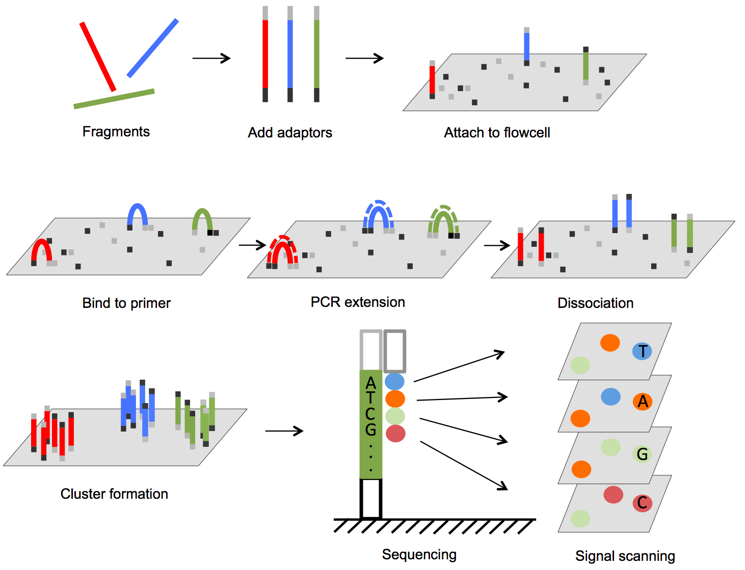
Another view of cluster formation for Illumina sequencing
From DOI: 10.5772/61657

Slide 24
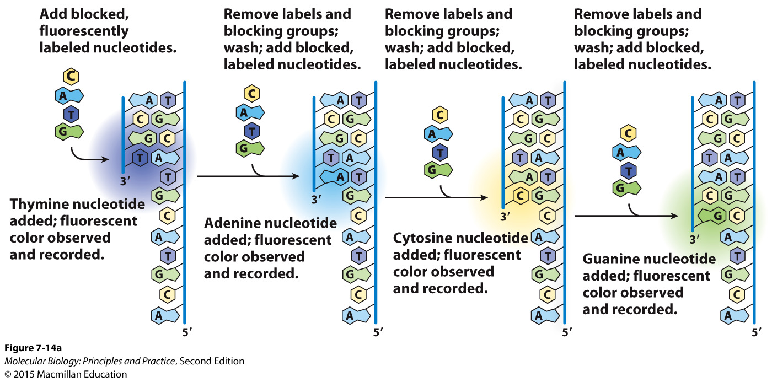
Modified nucleotide derivatives are used for Illumina sequencing

